Slide 1
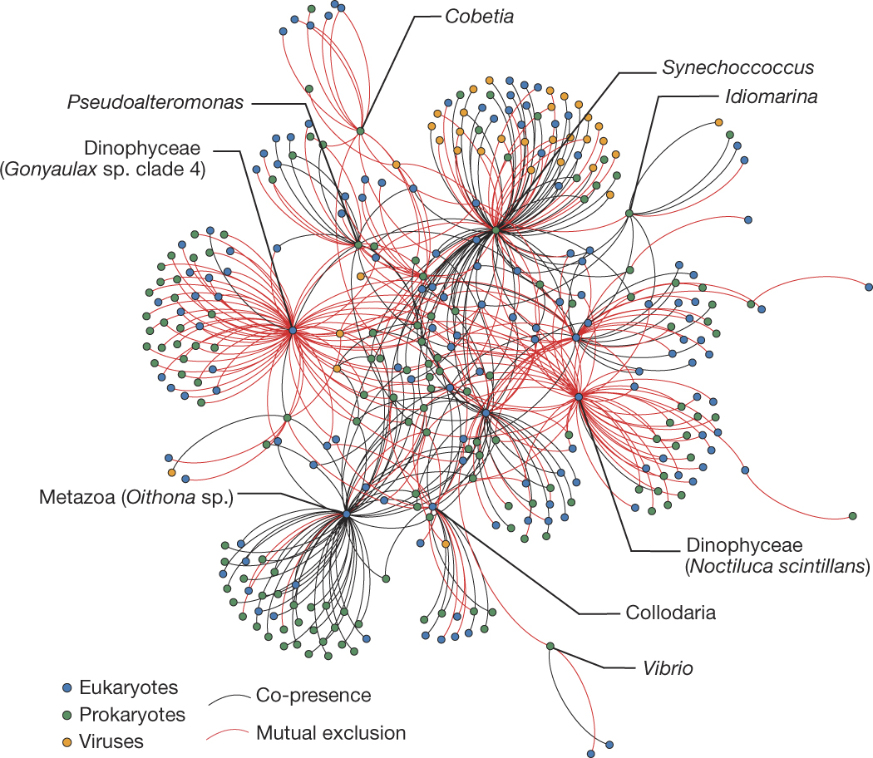

Analysis of microbial networks
Guidi et al. Nature 2016
Lisa Röttjers
Laboratory of Microbial Systems Biology
REGA institute, KU Leuven
ramellose/networktutorials

Slide 2
Overview
Case studies
Centrality measures
Keystones
Clustering algorithms
Robustness of network analysis

Slide 3
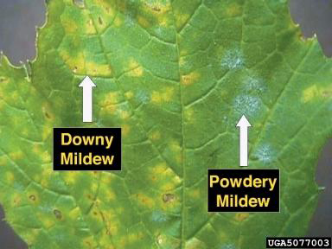
Pathogen inhibition in the plant phyllosphere
Phyllosphere: above-ground plant parts
Role of microbiome in pathogen establishment
Agler et al. (2016). Microbial hub taxa link host and abiotic factors to plant microbiome variation. PLoS biology, 14(1), e1002352.

Slide 4
Pathogen inhibition in the plant phyllosphere
Phyllosphere: above-ground plant parts
Role of microbiome in pathogen establishment
Hostile environment: limited nutrients & sunlight
Niche construction
Agler et al. (2016). Microbial hub taxa link host and abiotic factors to plant microbiome variation. PLoS biology, 14(1), e1002352.

Slide 5
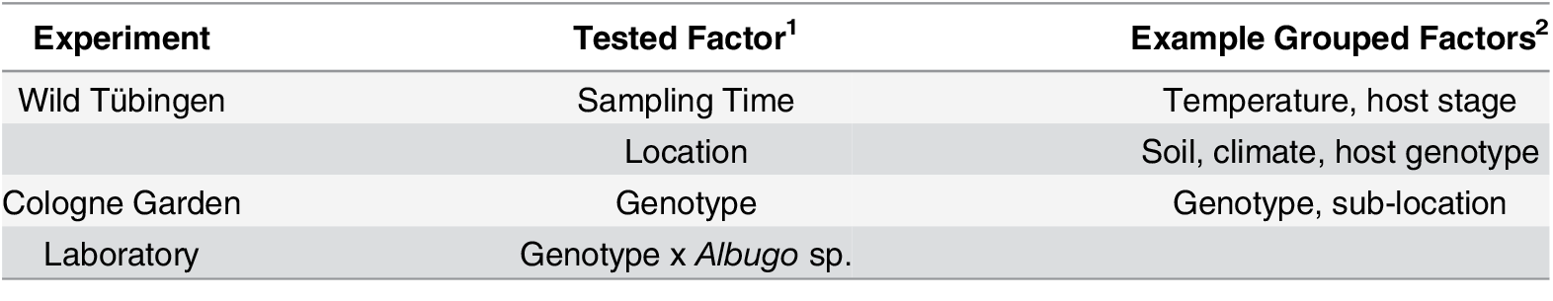
Phyllosphere microbiome
Wild Arabidopsis plants
16S rRNA + ITS
Agler et al. (2016). Microbial hub taxa link host and abiotic factors to plant microbiome variation. PLoS biology, 14(1), e1002352.

Slide 6
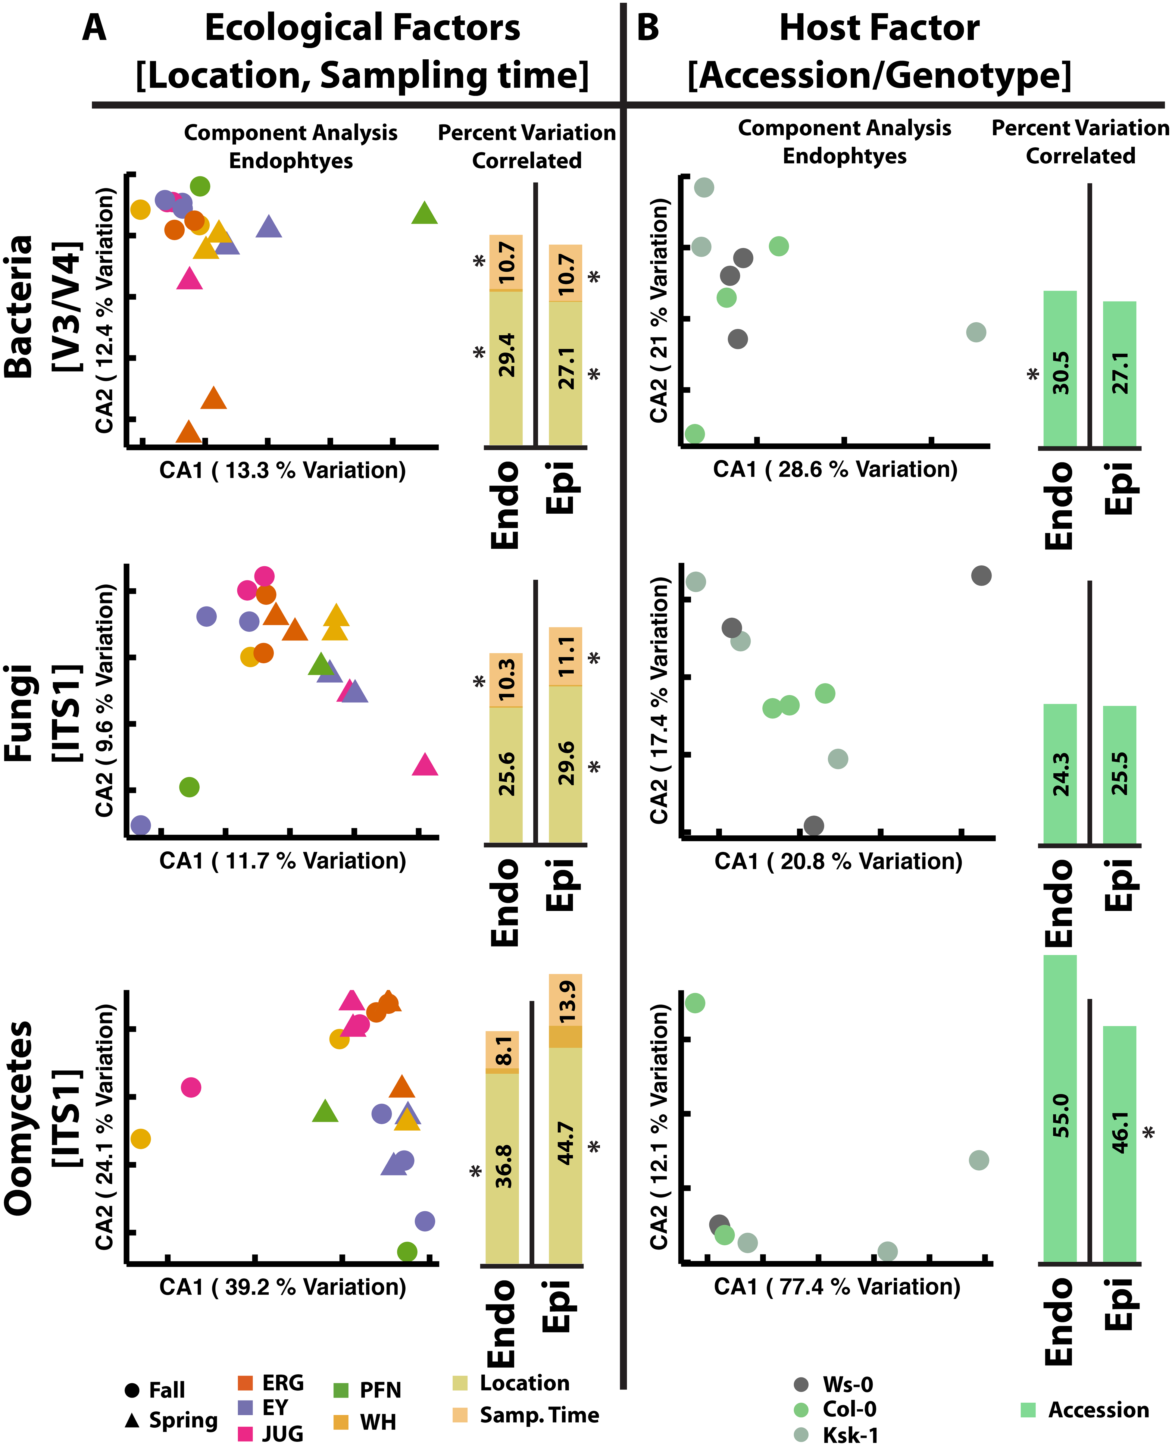
Phyllosphere microbiome
Wild Arabidopsis plants
16S rRNA + ITS
Agler et al. (2016). Microbial hub taxa link host and abiotic factors to plant microbiome variation. PLoS biology, 14(1), e1002352.

Slide 7
Phyllosphere microbiome
Wild Arabidopsis plants
16S rRNA + ITS
Agler et al. (2016). Microbial hub taxa link host and abiotic factors to plant microbiome variation. PLoS biology, 14(1), e1002352.

Slide 8
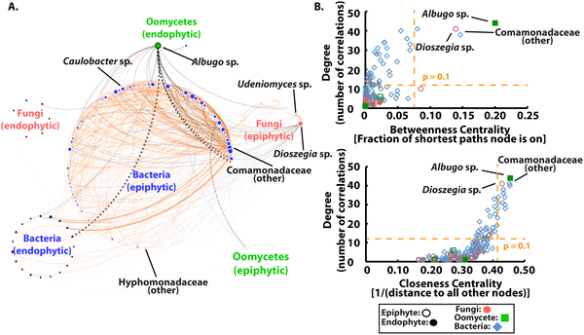
Phyllosphere network
Co-occurrence network (linear regression)
Tested edges by subsampling data
Agler et al. PLOS Biology 2016
Agler et al. (2016). Microbial hub taxa link host and abiotic factors to plant microbiome variation. PLoS biology, 14(1), e1002352.

Slide 9
Phyllosphere network
Co-occurrence network (linear regression)
Tested edges by subsampling data
Agler et al. PLOS Biology 2016
Agler et al. (2016). Microbial hub taxa link host and abiotic factors to plant microbiome variation. PLoS biology, 14(1), e1002352.

Slide 10
Phyllosphere network
Co-occurrence network (linear regression)
Tested edges by subsampling data
Agler et al. PLOS Biology 2016
Agler et al. (2016). Microbial hub taxa link host and abiotic factors to plant microbiome variation. PLoS biology, 14(1), e1002352.

Slide 11
Phyllosphere network
Co-occurrence network (linear regression)
Tested edges by subsampling data
Agler et al. PLOS Biology 2016
Agler et al. (2016). Microbial hub taxa link host and abiotic factors to plant microbiome variation. PLoS biology, 14(1), e1002352.

Slide 12
In silico testing of hubs
Effect of node removal on network structure
Remove node
Construct network from partial abundances
Count edges absent from partial network
Hub nodes: high values for all centralities
Positive control: high degree, low centrality
Negative control: high abundance, low degree, low centrality
Agler et al. (2016). Microbial hub taxa link host and abiotic factors to plant microbiome variation. PLoS biology, 14(1), e1002352.

Slide 13
In silico testing of hubs
Effect of node removal on network structure
Remove node
Construct network from partial abundances
Count edges absent from partial network
Hub nodes: high values for all centralities
Positive control: high degree, low centrality
Negative control: high abundance, low degree, low centrality
Agler et al. (2016). Microbial hub taxa link host and abiotic factors to plant microbiome variation. PLoS biology, 14(1), e1002352.

Slide 14
In silico testing of hubs
Effect of node removal on network structure
Remove node
Construct network from partial abundances
Count edges absent from partial network
Hub nodes: high values for all centralities
Positive control: high degree, low centrality
Negative control: high abundance, low degree, low centrality
Agler et al. (2016). Microbial hub taxa link host and abiotic factors to plant microbiome variation. PLoS biology, 14(1), e1002352.

Slide 15
In silico testing of hubs
Effect of node removal on network structure
Remove node
Construct network from partial abundances
Count edges absent from partial network
Hub nodes: high values for all centralities
Positive control: high degree, low centrality
Negative control: high abundance, low degree, low centrality
Agler et al. (2016). Microbial hub taxa link host and abiotic factors to plant microbiome variation. PLoS biology, 14(1), e1002352.

Slide 16
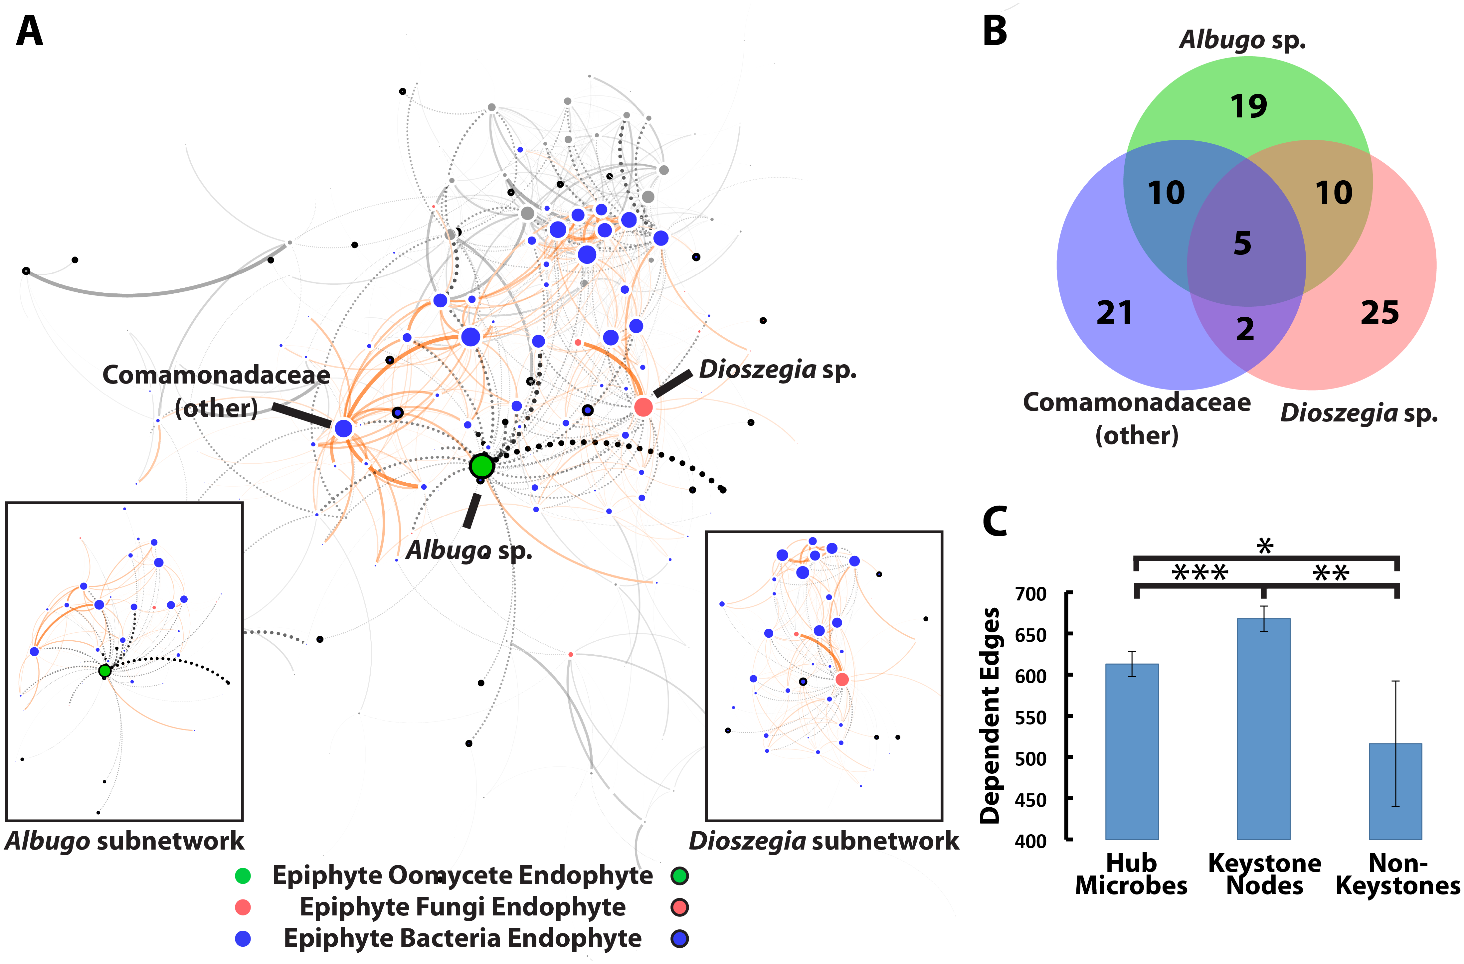
In silico testing of hubs
Most nodes neighbours of hubs
Most edges to hubs unique to hub species
Number of dependent edges largest for hubs
Agler et al. (2016). Microbial hub taxa link host and abiotic factors to plant microbiome variation. PLoS biology, 14(1), e1002352.

Slide 17
In silico testing of hubs
Most nodes neighbours of hubs
Most edges to hubs unique to hub species
Number of dependent edges largest for hubs
Agler et al. (2016). Microbial hub taxa link host and abiotic factors to plant microbiome variation. PLoS biology, 14(1), e1002352.

Slide 18
In silico testing of hubs
Most nodes neighbours of hubs
Most edges to hubs unique to hub species
Number of dependent edges largest for hubs
Agler et al. (2016). Microbial hub taxa link host and abiotic factors to plant microbiome variation. PLoS biology, 14(1), e1002352.

Slide 19
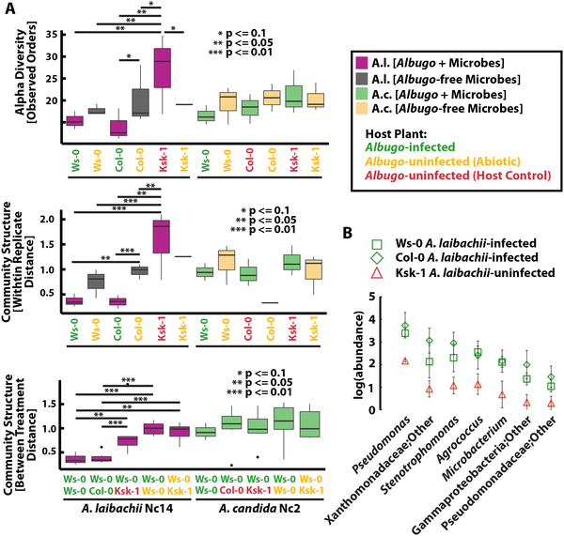
In silico =/= in vivo
Test effect of hubs (Albugo and Dioszegia)
Albugo not culturable, but transferable
Effect on alpha diversity and beta diversity
Dioszegia cocultures
Inhibited isolates
Agler et al. PLOS Biology 2016
Agler et al. (2016). Microbial hub taxa link host and abiotic factors to plant microbiome variation. PLoS biology, 14(1), e1002352.

Slide 20
In silico =/= in vivo
Test effect of hubs (Albugo and Dioszegia)
Albugo not culturable, but transferable
Effect on alpha diversity and beta diversity
Dioszegia cocultures
Inhibited isolates
Agler et al. PLOS Biology 2016
Agler et al. (2016). Microbial hub taxa link host and abiotic factors to plant microbiome variation. PLoS biology, 14(1), e1002352.

Slide 21
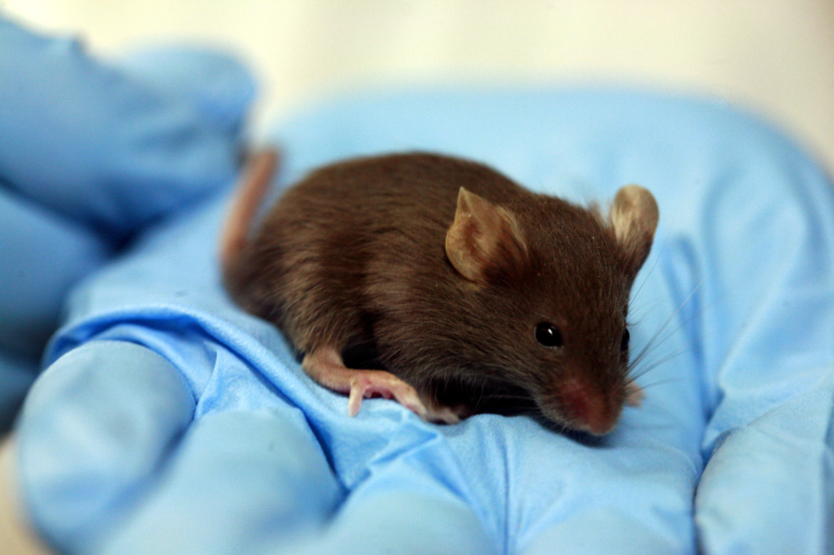
Antibiotic perturbation of the gut
Gut microbiota implicated in obesity
Known association between perturbation and development of metabolic dysfunction
Causal interactions undescribed
Mahana et al. (2016). Antibiotic perturbation of the murine gut microbiome enhances the adiposity, insulin resistance, and liver disease associated with high-fat diet. Genome medicine, 8(1), 48.

Slide 22
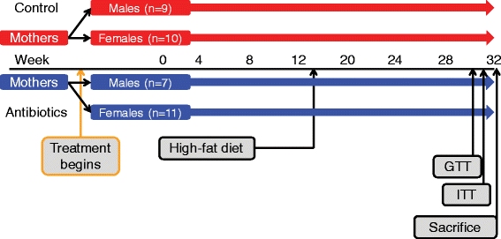
Mouse model of microbe-induced obesity
Mice exposed to long-term low-dose antibiotic (STAT)
Diet changed to high-fat diet
Characterize metabolic functions + microbiome
Mahana et al. Genome Medicine 2016
Mahana et al. (2016). Antibiotic perturbation of the murine gut microbiome enhances the adiposity, insulin resistance, and liver disease associated with high-fat diet. Genome medicine, 8(1), 48.

Slide 23
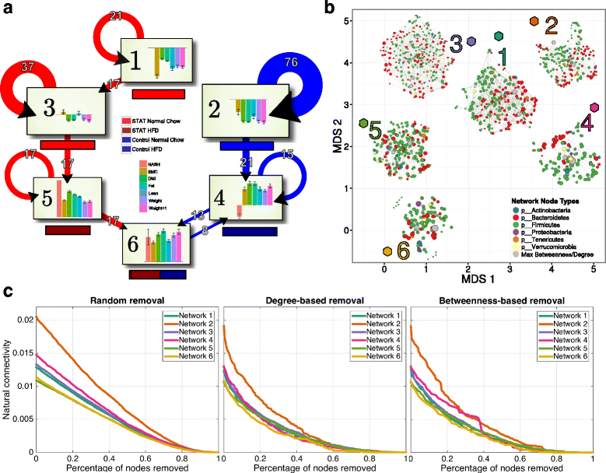
Community clusters
Inferred networks with SPIEC-EASI for each cluster
Mahana et al. (2016). Antibiotic perturbation of the murine gut microbiome enhances the adiposity, insulin resistance, and liver disease associated with high-fat diet. Genome medicine, 8(1), 48.

Slide 24
Community clusters
Inferred networks with SPIEC-EASI for each cluster
Clusters reflect STAT, control or both
Mahana et al. (2016). Antibiotic perturbation of the murine gut microbiome enhances the adiposity, insulin resistance, and liver disease associated with high-fat diet. Genome medicine, 8(1), 48.

Slide 25
Community clusters
Number of transitions
Inferred networks with SPIEC-EASI for each cluster
Clusters reflect STAT, control or both
Mahana et al. (2016). Antibiotic perturbation of the murine gut microbiome enhances the adiposity, insulin resistance, and liver disease associated with high-fat diet. Genome medicine, 8(1), 48.

Slide 26
Subnetworks
Simulated network attacks
Mahana et al. (2016). Antibiotic perturbation of the murine gut microbiome enhances the adiposity, insulin resistance, and liver disease associated with high-fat diet. Genome medicine, 8(1), 48.

Slide 27
Subnetworks
Simulated network attacks
STAT-associated networks more sensitive than control
Mahana et al. (2016). Antibiotic perturbation of the murine gut microbiome enhances the adiposity, insulin resistance, and liver disease associated with high-fat diet. Genome medicine, 8(1), 48.

Slide 28
Subnetworks
Simulated network attacks
STAT-associated networks more sensitive than control
Model for sensitivity to antibiotics?
Mahana et al. (2016). Antibiotic perturbation of the murine gut microbiome enhances the adiposity, insulin resistance, and liver disease associated with high-fat diet. Genome medicine, 8(1), 48.

Slide 29
Take-home message
Whole network: likely to show treatment group differences
Subnetworks can show within-group community
Node removal analysis can help assess node importance
Note: network robustness is not known to reflect biological robustness

Slide 30
Centrality measures
Degree
Hub nodes

Slide 31
Centrality measures
2
2
Degree
Hub nodes
1
5
3
3
1
4
4
4
2
2

Slide 32
Centrality measures
1
2
Degree (positive)
Hub nodes
1
4
1
3
1
3
4
2
2
1

Slide 33
Centrality measures
1
0
Degree (negative)
Hub nodes
0
0
2
0
0
1
0
2
0
1

Slide 34
Centrality measures
Degree
Hub nodes
Betweenness centrality
# Shortest paths

Slide 35
Centrality measures
Degree
Hub nodes
Betweenness centrality
# Shortest paths

Slide 36
Centrality measures
Degree
Hub nodes
Betweenness centrality
# Shortest paths

Slide 37
Centrality measures
Degree
Hub nodes
Betweenness centrality
# Shortest paths
Closeness centrality
Length of paths

Slide 38
Centrality measures
Degree
Hub nodes
Betweenness centrality
# Shortest paths
Closeness centrality
Length of paths

Slide 39
Centrality measures
Degree
Hub nodes
Betweenness centrality
# Shortest paths
Closeness centrality
Length of paths

Slide 40
Centrality measures
Degree
Hub nodes
Betweenness centrality
# Shortest paths
Closeness centrality
Length of paths
Eigenvector centrality
Proximity to important nodes

Slide 41
Centrality measures
Types of flow processes
Borgatti (2005). Centrality and network flow. Social networks, 27(1), 55-71.

Slide 42

Centrality measures
Types of flow processes
Used goods
Borgatti (2005). Centrality and network flow. Social networks, 27(1), 55-71.

Slide 43
Centrality measures
Types of flow processes
Used goods
Borgatti (2005). Centrality and network flow. Social networks, 27(1), 55-71.

Slide 44
Centrality measures
Types of flow processes
Used goods
Borgatti (2005). Centrality and network flow. Social networks, 27(1), 55-71.

Slide 45
Centrality measures
Types of flow processes
Used goods
Borgatti (2005). Centrality and network flow. Social networks, 27(1), 55-71.

Slide 46
Centrality measures
Types of flow processes
Used goods
Trail – no link is repeated
Borgatti (2005). Centrality and network flow. Social networks, 27(1), 55-71.

Slide 47

Centrality measures
Types of flow processes
Used goods
Trail – no link is repeated
Money
Borgatti (2005). Centrality and network flow. Social networks, 27(1), 55-71.

Slide 48
Centrality measures
Types of flow processes
Used goods
Trail – no link is repeated
Money
Borgatti (2005). Centrality and network flow. Social networks, 27(1), 55-71.

Slide 49
Centrality measures
Types of flow processes
Used goods
Trail – no link is repeated
Money
Borgatti (2005). Centrality and network flow. Social networks, 27(1), 55-71.

Slide 50
Centrality measures
Types of flow processes
Used goods
Trail – no link is repeated
Money
Borgatti (2005). Centrality and network flow. Social networks, 27(1), 55-71.

Slide 51
Centrality measures
Types of flow processes
Used goods
Trail – no link is repeated
Money
Borgatti (2005). Centrality and network flow. Social networks, 27(1), 55-71.

Slide 52
Centrality measures
Types of flow processes
Used goods
Trail – no link is repeated
Money
Borgatti (2005). Centrality and network flow. Social networks, 27(1), 55-71.

Slide 53
Centrality measures
Types of flow processes
Used goods
Trail – no link is repeated
Money
Walk
Markov process
Borgatti (2005). Centrality and network flow. Social networks, 27(1), 55-71.

Slide 54
Centrality measures
Degree centrality
Types of flow processes
Used goods
Trail – no link is repeated
Money
Walk
Markov process
Borgatti (2005). Centrality and network flow. Social networks, 27(1), 55-71.

Slide 55

Centrality measures
Types of flow processes
Used goods
Trail – no link is repeated
Money
Walk
Markov process
Gossip
Borgatti (2005). Centrality and network flow. Social networks, 27(1), 55-71.

Slide 56
Centrality measures
Types of flow processes
Used goods
Trail – no link is repeated
Money
Walk
Markov process
Gossip
Borgatti (2005). Centrality and network flow. Social networks, 27(1), 55-71.

Slide 57
Centrality measures
Types of flow processes
Used goods
Trail – no link is repeated
Money
Walk
Markov process
Gossip
Borgatti (2005). Centrality and network flow. Social networks, 27(1), 55-71.

Slide 58
Centrality measures
Types of flow processes
Used goods
Trail – no link is repeated
Money
Walk
Markov process
Gossip
Borgatti (2005). Centrality and network flow. Social networks, 27(1), 55-71.

Slide 59
Centrality measures
Types of flow processes
Used goods
Trail – no link is repeated
Money
Walk
Markov process
Gossip
Borgatti (2005). Centrality and network flow. Social networks, 27(1), 55-71.

Slide 60
Centrality measures
Types of flow processes
Used goods
Trail – no link is repeated
Money
Walk
Markov process
Gossip
Trail
Borgatti (2005). Centrality and network flow. Social networks, 27(1), 55-71.

Slide 61
Centrality measures
Eigenvector centrality
Types of flow processes
Used goods
Trail – no link is repeated
Money
Walk
Markov process
Gossip
Trail
Borgatti (2005). Centrality and network flow. Social networks, 27(1), 55-71.

Slide 62

Centrality measures
Types of flow processes
Used goods
Trail – no link is repeated
Money
Walk
Markov process
Gossip - parallel
Trail
Borgatti (2005). Centrality and network flow. Social networks, 27(1), 55-71.

Slide 63
Centrality measures
Types of flow processes
Used goods
Trail – no link is repeated
Money
Walk
Markov process
Gossip - parallel
Trail
Borgatti (2005). Centrality and network flow. Social networks, 27(1), 55-71.

Slide 64
Centrality measures
Types of flow processes
Used goods
Trail – no link is repeated
Money
Walk
Markov process
Gossip - parallel
Trail
Borgatti (2005). Centrality and network flow. Social networks, 27(1), 55-71.

Slide 65
Centrality measures
Closeness centrality
Types of flow processes
Used goods
Trail – no link is repeated
Money
Walk
Markov process
Gossip - parallel
Trail
Degree centrality
Borgatti (2005). Centrality and network flow. Social networks, 27(1), 55-71.

Slide 66

Centrality measures
Types of flow processes
Used goods
Trail – no link is repeated
Money
Walk
Markov process
Gossip
Trail
Packages
Borgatti (2005). Centrality and network flow. Social networks, 27(1), 55-71.

Slide 67
Centrality measures
Types of flow processes
Used goods
Trail – no link is repeated
Money
Walk
Markov process
Gossip
Trail
Packages
Borgatti (2005). Centrality and network flow. Social networks, 27(1), 55-71.

Slide 68
Centrality measures
Types of flow processes
Used goods
Trail – no link is repeated
Money
Walk
Markov process
Gossip
Trail
Packages
Borgatti (2005). Centrality and network flow. Social networks, 27(1), 55-71.

Slide 69
Centrality measures
Types of flow processes
Used goods
Trail – no link is repeated
Money
Walk
Markov process
Gossip
Trail
Packages
Borgatti (2005). Centrality and network flow. Social networks, 27(1), 55-71.

Slide 70
Centrality measures
Types of flow processes
Used goods
Trail – no link is repeated
Money
Walk
Markov process
Gossip
Trail
Packages
Shortest path
Borgatti (2005). Centrality and network flow. Social networks, 27(1), 55-71.

Slide 71
Centrality measures
Closeness centrality
Types of flow processes
Used goods
Trail – no link is repeated
Money
Walk
Markov process
Gossip
Trail
Packages
Shortest path
Betweenness centrality
Borgatti (2005). Centrality and network flow. Social networks, 27(1), 55-71.

Slide 72
Centrality measures
Types of flow processes
Replication or diffusion?

Slide 73
Centrality measures
Types of flow processes
Replication or diffusion?
Serial or parallel?

Slide 74
Centrality measures
Types of flow processes
Replication or diffusion?
Serial or parallel?
Deterministic or undirected?

Slide 75
Centrality measures
Types of flow processes
Replication or diffusion?
Serial or parallel?
Deterministic or undirected?
Paths, trails or walks?
Why does it matter what processes are going on?

Slide 76
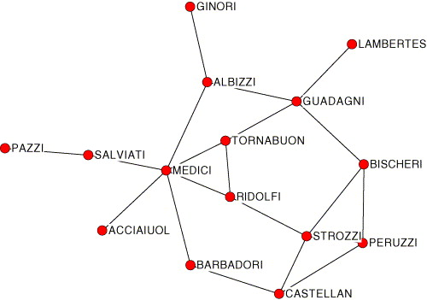
Centrality measures
Borgatti (2005). Centrality and network flow. Social networks, 27(1), 55-71.

Slide 77
Centrality measures
Simulated flow processes
Package process
Mooching
Used goods
Gossip
Infections
Money
Borgatti (2005). Centrality and network flow. Social networks, 27(1), 55-71.

Slide 78
Centrality measures
Outcomes
Central actors in gossip processes not captured in shortest paths
Node importance is interaction between position and flow process
Untargeted flows not well modelled
Borgatti (2005). Centrality and network flow. Social networks, 27(1), 55-71.

Slide 79
Centrality measures
How to choose?

Slide 80
Centrality measures
How to choose?
Competing clusters: betweenness centrality?

Slide 81
Centrality measures
How to choose?
Competing clusters: betweenness centrality?
Primary degrader: eigenvector centrality?

Slide 82
Centrality measures
How to choose?
Competing clusters: betweenness centrality?
Primary degrader: eigenvector centrality?
Effect of microbial dynamics on network topology

Slide 83
Centrality measures
No systematic studies on effect of dynamics on network structure
Agler et al. (2016). Microbial hub taxa link host and abiotic factors to plant microbiome variation. PLoS biology, 14(1), e1002352.

Slide 84
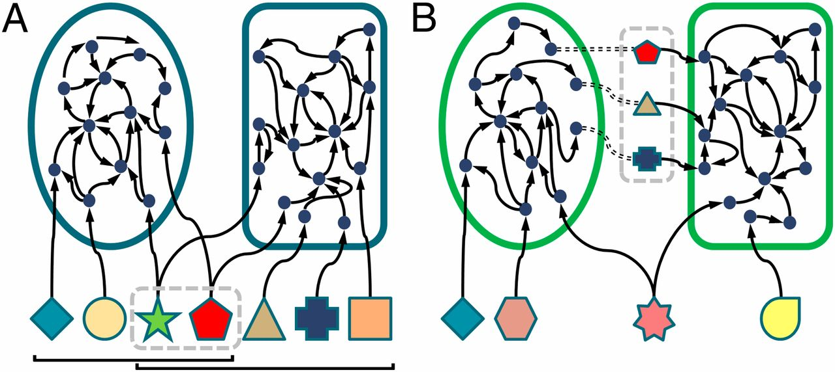
Centrality measures
No systematic studies on effect of dynamics on network structure
Validate what you can!
Literature
Metabolic complementarity
Levy & Borenstein. (2013). Metabolic modeling of species interaction in the human microbiome elucidates community-level assembly rules. Proceedings of the National Academy of Sciences, 110(31), 12804-12809.

Slide 85
Centrality measures
No systematic studies on effect of dynamics on network structure
Validate what you can!
Literature
Metabolic complementarity
Correlate network properties to confounders, environmental factors, bacterial properties

Slide 86
Assortativity
Measures node similarity

Slide 87
Assortativity
Measures node similarity
Pearson correlation of degree between linked nodes

Slide 88
Assortativity
Measures node similarity
Pearson correlation of degree between linked nodes
Degree

Slide 89
Assortativity
Measures node similarity
Pearson correlation of degree between linked nodes
Degree
Assortative

Slide 90
Assortativity
Measures node similarity
Pearson correlation of degree between linked nodes
Degree
Disassortative
Assortative

Slide 91
Assortativity
Measures node similarity
Pearson correlation of degree between linked nodes
Degree
Positive degree
Negative degree
Disassortative
Assortative

Slide 92
Assortativity
Measures node similarity
Pearson correlation of degree between linked nodes
Degree
Positive degree
Negative degree
Any other centrality

Slide 93
Assortativity
Measures node similarity
Pearson correlation of degree between linked nodes
Degree
Positive degree
Negative degree
Any other centrality
Phylogenetic

Slide 94
Assortativity
Assortative
Measures node similarity
Pearson correlation of degree between linked nodes
Degree
Positive degree
Negative degree
Any other centrality
Phylogenetic
Assortative

Slide 95
Assortativity
Assortative
Measures node similarity
Pearson correlation of degree between linked nodes
Degree
Positive degree
Negative degree
Any other centrality
Phylogenetic
Assortative
Disassortative

Slide 96
Assortativity
Measures node similarity
Pearson correlation of degree between linked nodes
Degree
Positive degree
Negative degree
Any other centrality
Phylogenetic

Slide 97
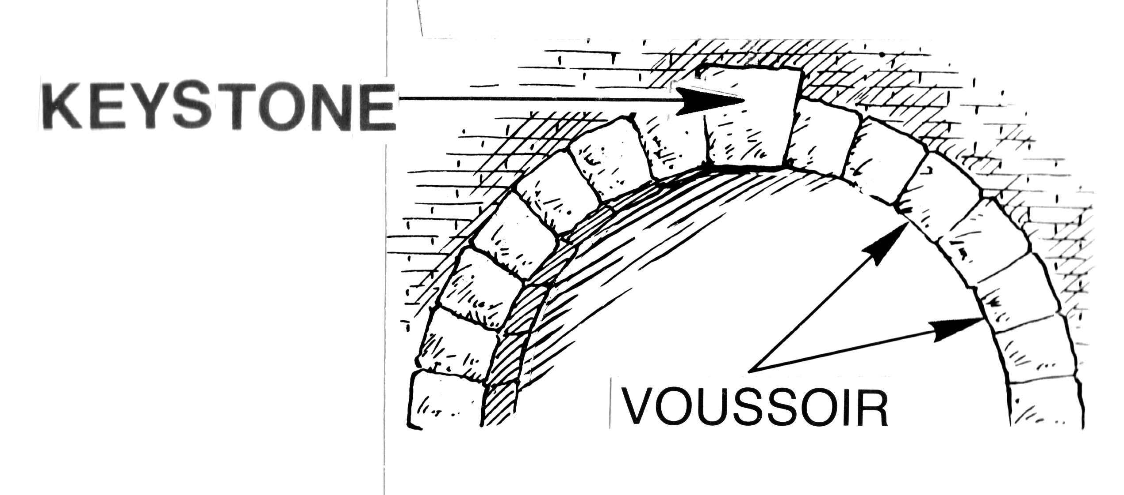
Keystone species
Unique role in ecosystem
Removal changes ecosystem
Negative change
Not necessarily abundant

Slide 98
Keystone species
Unique role in ecosystem
Removal changes ecosystem
Negative change
Not necessarily abundant
Do keystone species exist in the microbiome?

Slide 99
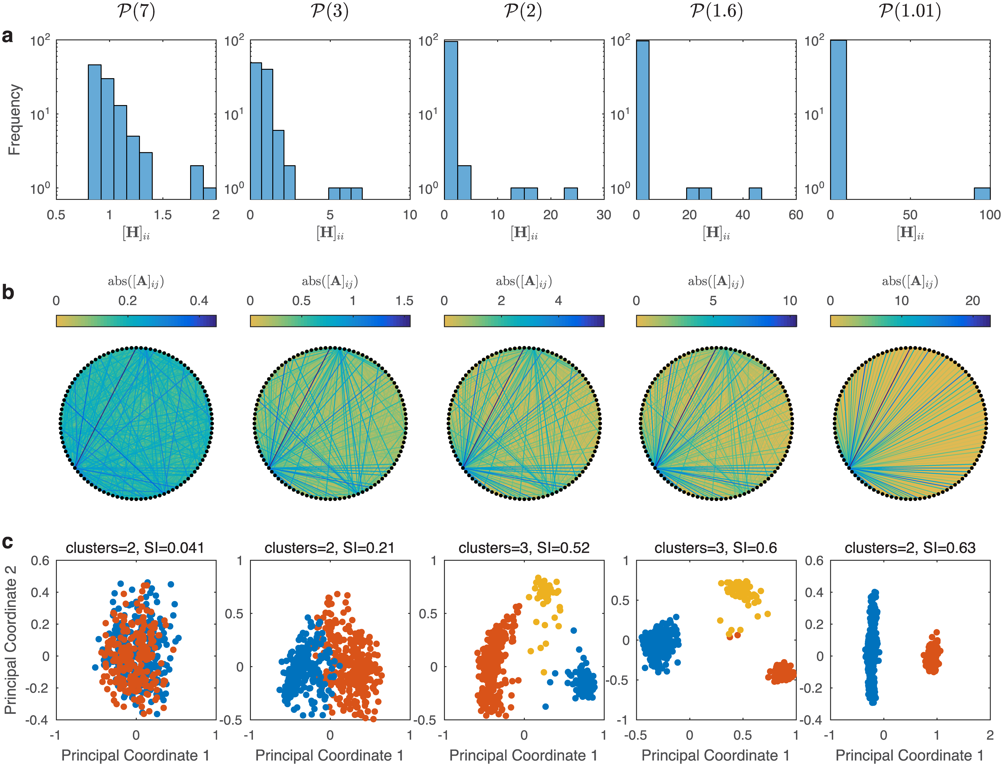
Keystone species
Strongly Interacting Species
Can control community type
Effect not necessarily negative
Gibson et al. (2016). On the origins and control of community types in the human microbiome. PLoS computational biology, 12(2), e1004688.

Slide 100
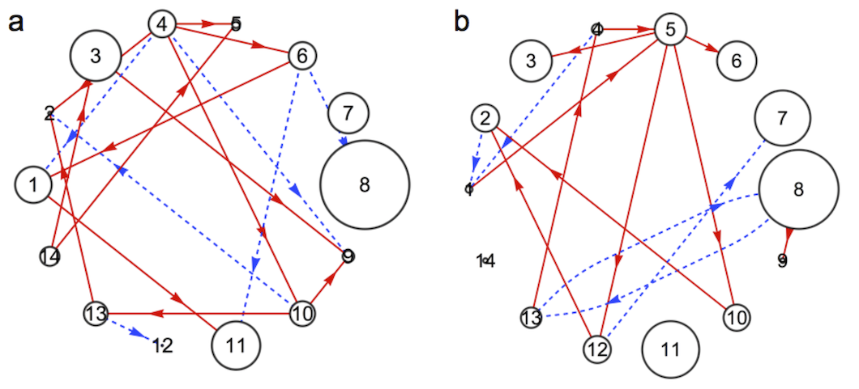
Keystone species
Can be identified through centrality
Degree
Fisher & Mehta. (2014). Identifying keystone species in the human gut microbiome from metagenomic timeseries using sparse linear regression. PloS one, 9(7), e102451.

Slide 101
Keystone species
Can be identified through centrality
Degree
How reliable are networks as keystone indicators?
Fisher & Mehta. (2014). Identifying keystone species in the human gut microbiome from metagenomic timeseries using sparse linear regression. PloS one, 9(7), e102451.

Slide 102
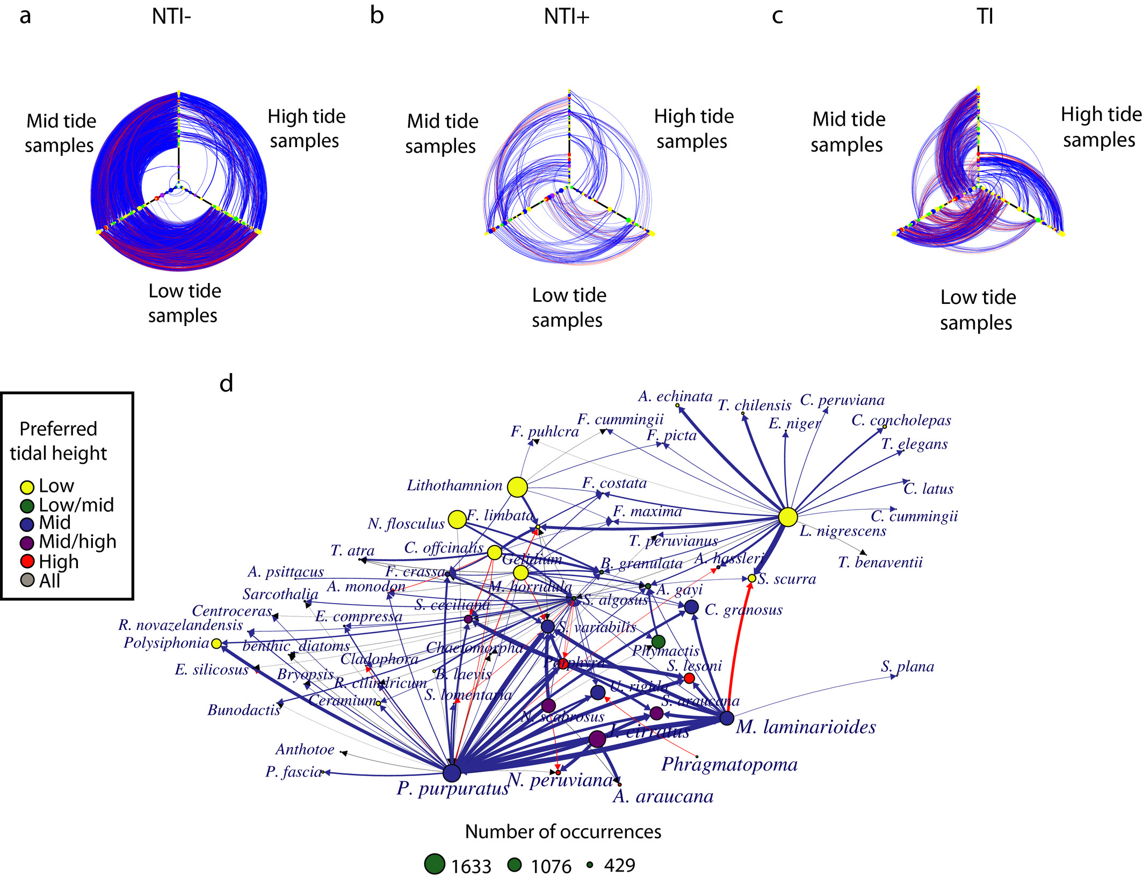
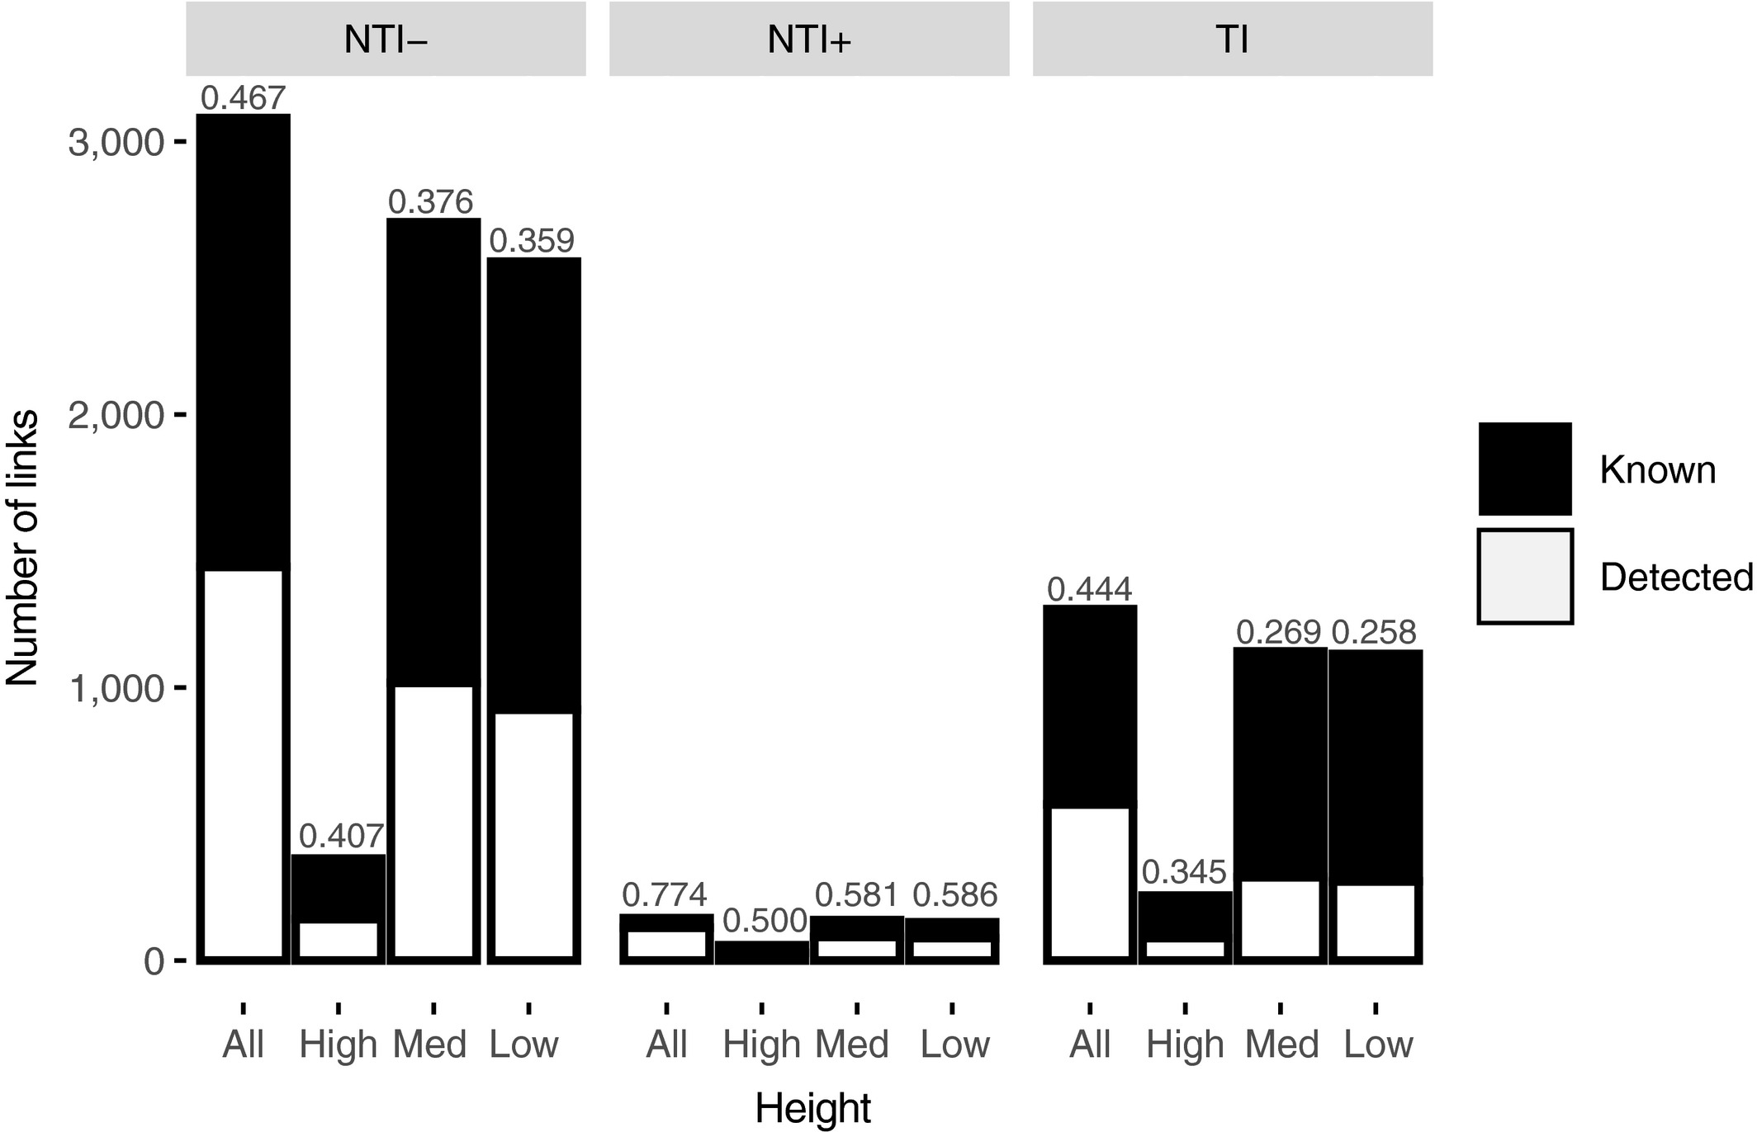
Keystone species
Known interaction network
Freilich et al. (2018). Species co‐occurrence networks: Can they reveal trophic and non‐trophic interactions in ecological communities?. Ecology, 99(3), 690-699.

Slide 103
Keystone species
Known interaction network
Freilich et al. (2018). Species co‐occurrence networks: Can they reveal trophic and non‐trophic interactions in ecological communities?. Ecology, 99(3), 690-699.

Slide 104
Keystone species
Known interaction network
Non-trophic interactions
Freilich et al. (2018). Species co‐occurrence networks: Can they reveal trophic and non‐trophic interactions in ecological communities?. Ecology, 99(3), 690-699.

Slide 105
Keystone species
Known interaction network
Trophic interactions
Freilich et al. (2018). Species co‐occurrence networks: Can they reveal trophic and non‐trophic interactions in ecological communities?. Ecology, 99(3), 690-699.

Slide 106
Keystone species
Known interaction network
Trophic interactions less detected
Freilich et al. (2018). Species co‐occurrence networks: Can they reveal trophic and non‐trophic interactions in ecological communities?. Ecology, 99(3), 690-699.

Slide 107
Keystone species
Known interaction network
Trophic interactions less detected
Inferred co-occurrence network
Freilich et al. (2018). Species co‐occurrence networks: Can they reveal trophic and non‐trophic interactions in ecological communities?. Ecology, 99(3), 690-699.

Slide 108
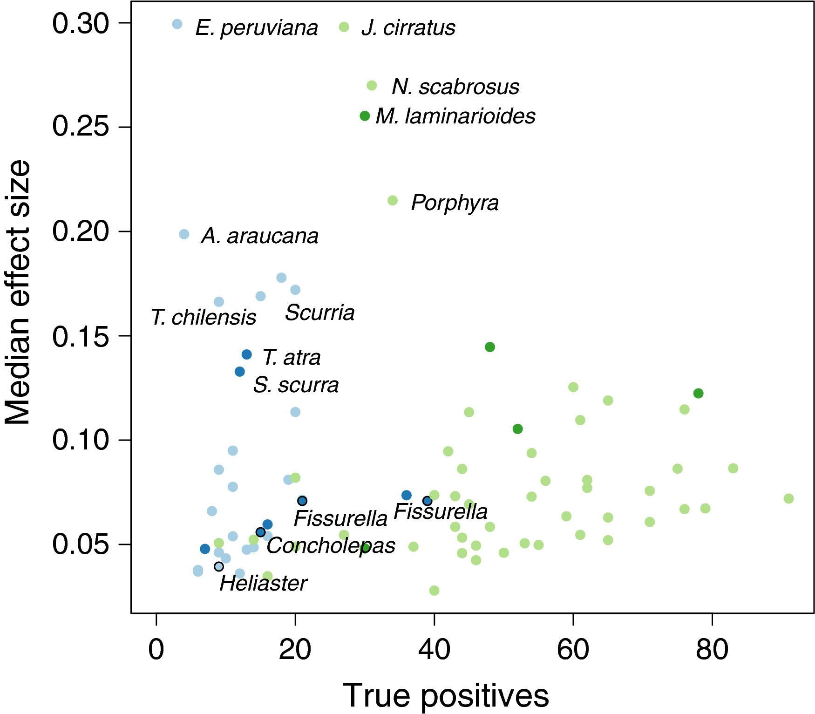
Keystone species
Effect size (sum of correlations) largest for generalist herbivores
Freilich et al. (2018). Species co‐occurrence networks: Can they reveal trophic and non‐trophic interactions in ecological communities?. Ecology, 99(3), 690-699.

Slide 109
Keystone species
Effect size (sum of correlations) largest for generalist herbivores
Keystones not different from other species
Freilich et al. (2018). Species co‐occurrence networks: Can they reveal trophic and non‐trophic interactions in ecological communities?. Ecology, 99(3), 690-699.

Slide 110
Keystone species
Effect size (sum of correlations) largest for generalist herbivores
Keystones not different from other species
Freilich et al. (2018). Species co‐occurrence networks: Can they reveal trophic and non‐trophic interactions in ecological communities?. Ecology, 99(3), 690-699.

Slide 111
Keystone species
Effect size (sum of correlations) largest for generalist herbivores
Keystones not different from other species
Co-occurrence networks may not recover associations with keystones
Freilich et al. (2018). Species co‐occurrence networks: Can they reveal trophic and non‐trophic interactions in ecological communities?. Ecology, 99(3), 690-699.

Slide 112
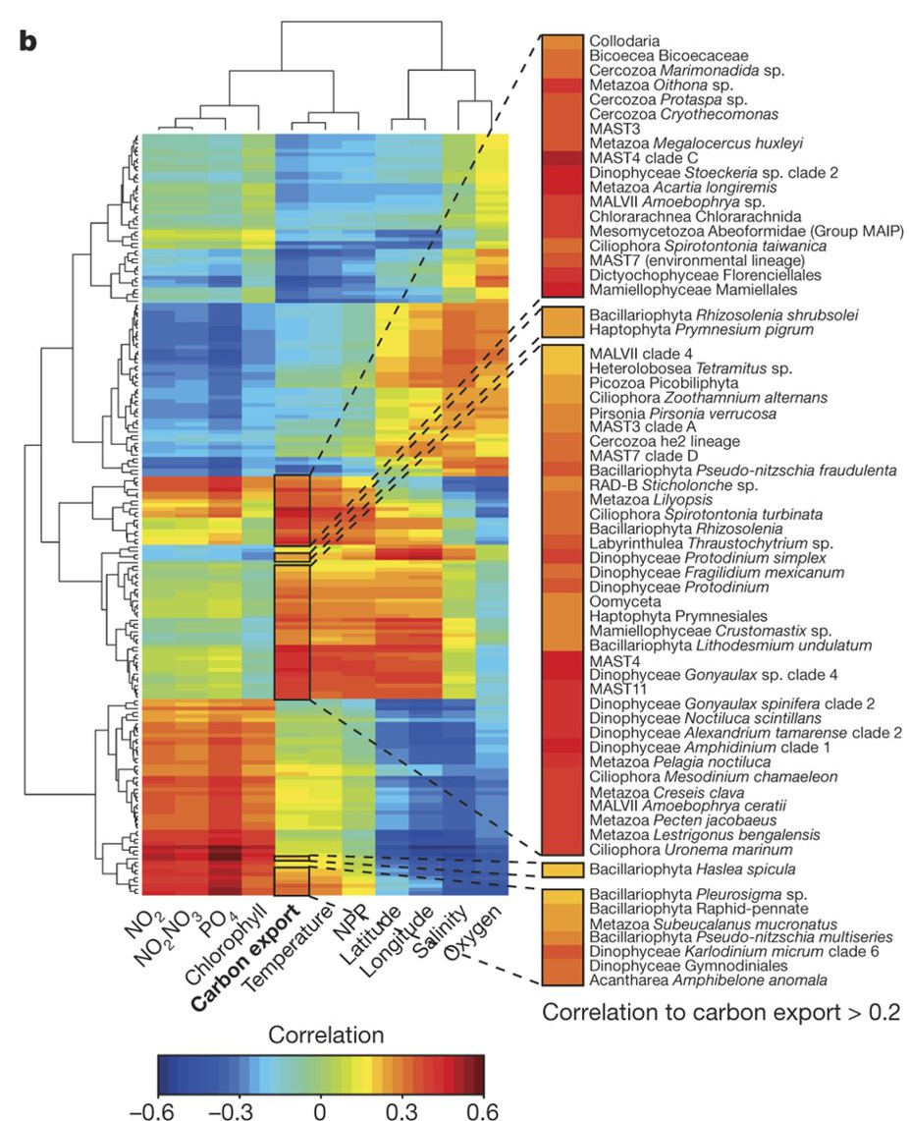
Cluster analysis
TARA Oceans cruise data
Regression model shows correlations to environmental factors
Guidi et al. (2016). Plankton networks driving carbon export in the oligotrophic ocean. Nature, 532(7600), 465.

Slide 113
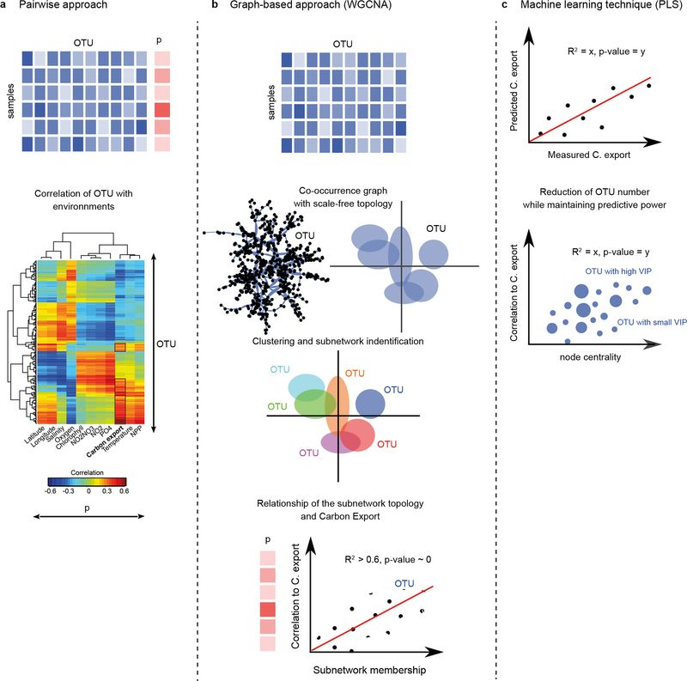
Cluster analysis
WGCNA generates clusters
Guidi et al. (2016). Plankton networks driving carbon export in the oligotrophic ocean. Nature, 532(7600), 465.

Slide 114
Cluster analysis
WGCNA generates clusters
Guidi et al. (2016). Plankton networks driving carbon export in the oligotrophic ocean. Nature, 532(7600), 465.

Slide 115
Cluster analysis
WGCNA generates clusters
Guidi et al. (2016). Plankton networks driving carbon export in the oligotrophic ocean. Nature, 532(7600), 465.

Slide 116
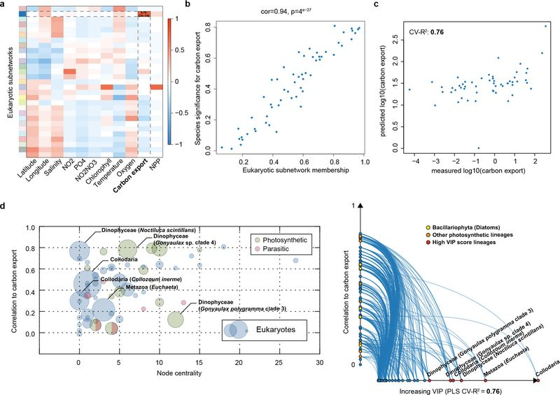
Cluster analysis
WGCNA generates clusters
Guidi et al. (2016). Plankton networks driving carbon export in the oligotrophic ocean. Nature, 532(7600), 465.

Slide 117
Cluster analysis
WGCNA generates clusters
Subnetworks selected based on correlation
Guidi et al. (2016). Plankton networks driving carbon export in the oligotrophic ocean. Nature, 532(7600), 465.

Slide 118
Cluster analysis
WGCNA generates clusters
Subnetworks selected based on correlation
VIP determined through PLS
Guidi et al. (2016). Plankton networks driving carbon export in the oligotrophic ocean. Nature, 532(7600), 465.

Slide 119
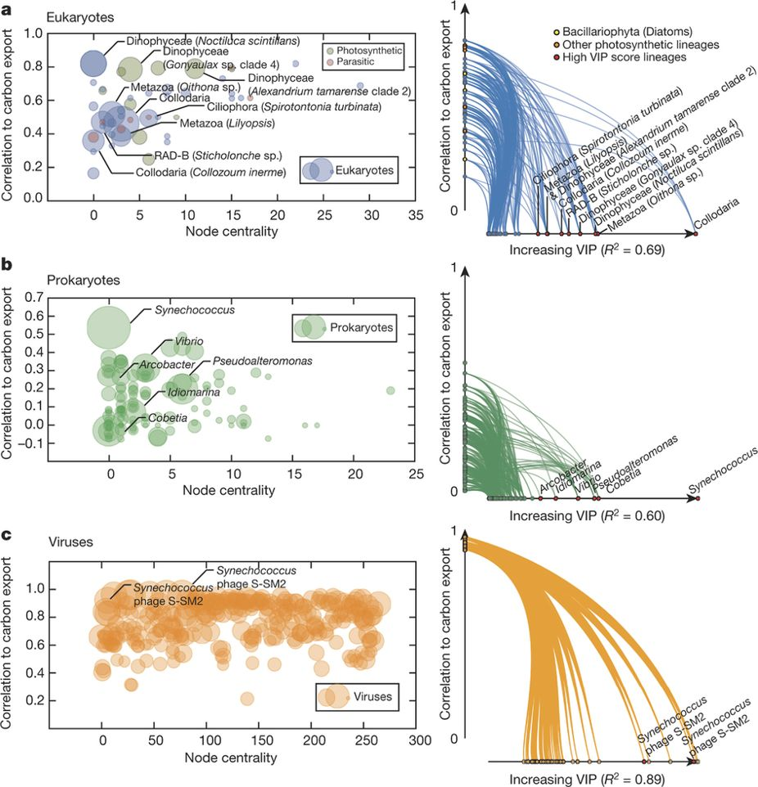
Cluster analysis
WGCNA generates clusters
Subnetworks selected based on correlation
Guidi et al. (2016). Plankton networks driving carbon export in the oligotrophic ocean. Nature, 532(7600), 465.

Slide 120
Cluster analysis
WGCNA generates clusters
Subnetworks selected based on correlation
Nodes with VIP > 1 selected
Guidi et al. (2016). Plankton networks driving carbon export in the oligotrophic ocean. Nature, 532(7600), 465.

Slide 121
Cluster analysis
Integrated subnetworks highlight importance of Synechococcus and associated phages
Guidi et al. (2016). Plankton networks driving carbon export in the oligotrophic ocean. Nature, 532(7600), 465.

Slide 122
Cluster analysis
Integrated subnetworks highlight importance of Synechococcus and associated phages
Guidi et al. (2016). Plankton networks driving carbon export in the oligotrophic ocean. Nature, 532(7600), 465.

Slide 123
Clusters
Clusters can reveal important nodes and correlations to environmental factors
How do you identify a cluster?

Slide 124
Clusters
Many algorithms for clustering available
WGCNA
MCL
Louvain clustering
OH-PIN
Walktrap
Girvan-Newman

Slide 125
Clusters
Many algorithms for clustering available
WGCNA
MCL
Louvain clustering
OH-PIN
Walktrap
Girvan-Newman
Choice for criteria is not obvious

Slide 126
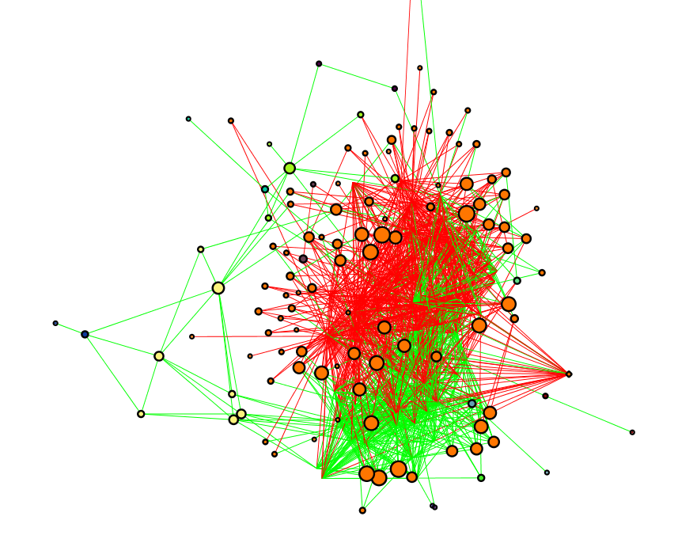
Clusters
MCL, all edges
Many algorithms for clustering available
WGCNA
MCL
Louvain clustering
OH-PIN
Walktrap
Girvan-Newman
Choice for criteria is not obvious

Slide 127
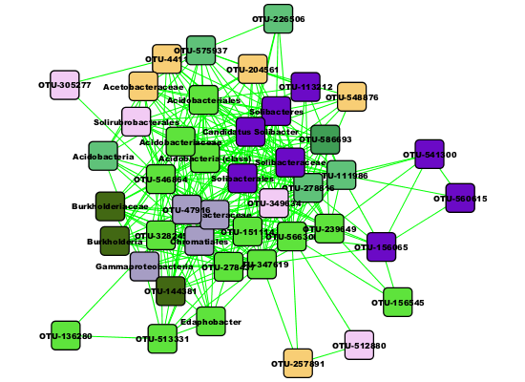
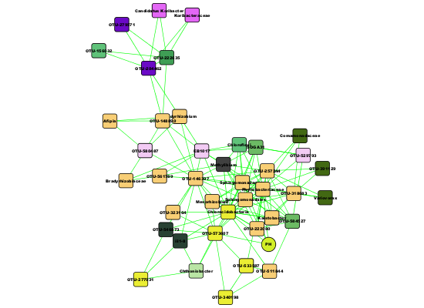
Clusters
Many algorithms for clustering available
WGCNA
MCL
Louvain clustering
OH-PIN
Walktrap
Girvan-Newman
Choice for criteria is not obvious
OH-PIN, positive edges only

Slide 128
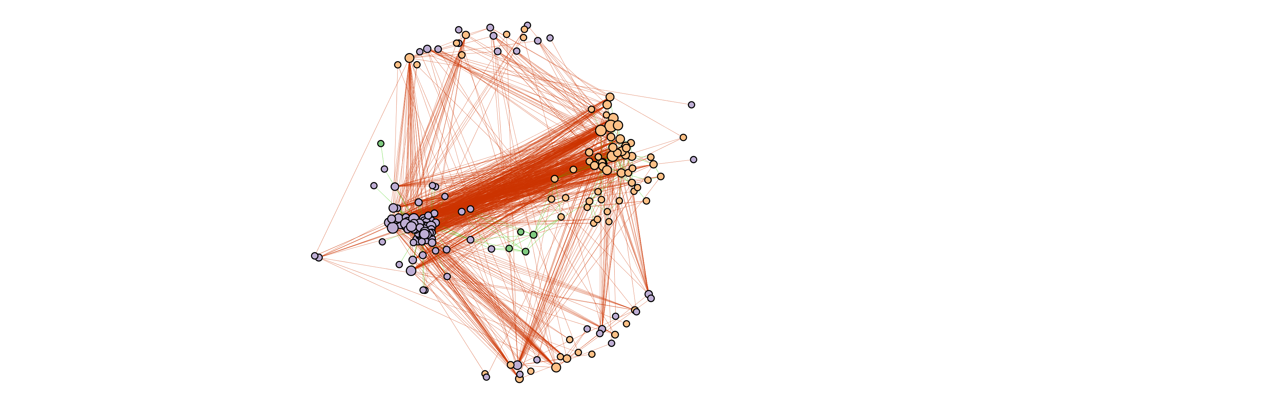
Clusters
Force directed layout algorithm on edge weights

Slide 129
Clusters
Force directed layout algorithm on edge weights

Slide 130
Robustness of microbial networks
How do you know if your network is “ok”?

Slide 131
Permutation testing
Permute original data

Slide 132
Permutation testing
Permute original data
Test robustness of edges

Slide 133
Permutation testing
Permute original data
Test robustness of edges
Remove unstable edges

Slide 134
Permutation testing
Permute original data
Test robustness of edges
Remove unstable edges
Implemented in CoNet and SPIEC-EASI

Slide 135
Permutation testing
Permute inferred network

Slide 136
Permutation testing
Permute inferred network

Slide 137
Permutation testing
Permute inferred network
Estimate fraction of stable centralities
Frantz & Carley. (2017). Reporting a network’s most-central actor with a confidence level. Computational and Mathematical Organization Theory, 23(2), 301-312.

Slide 138
Permutation testing
Permute inferred network
Estimate fraction of stable centralities
Note: clusters less dependent on specific associations
Frantz & Carley. (2017). Reporting a network’s most-central actor with a confidence level. Computational and Mathematical Organization Theory, 23(2), 301-312.

Slide 139
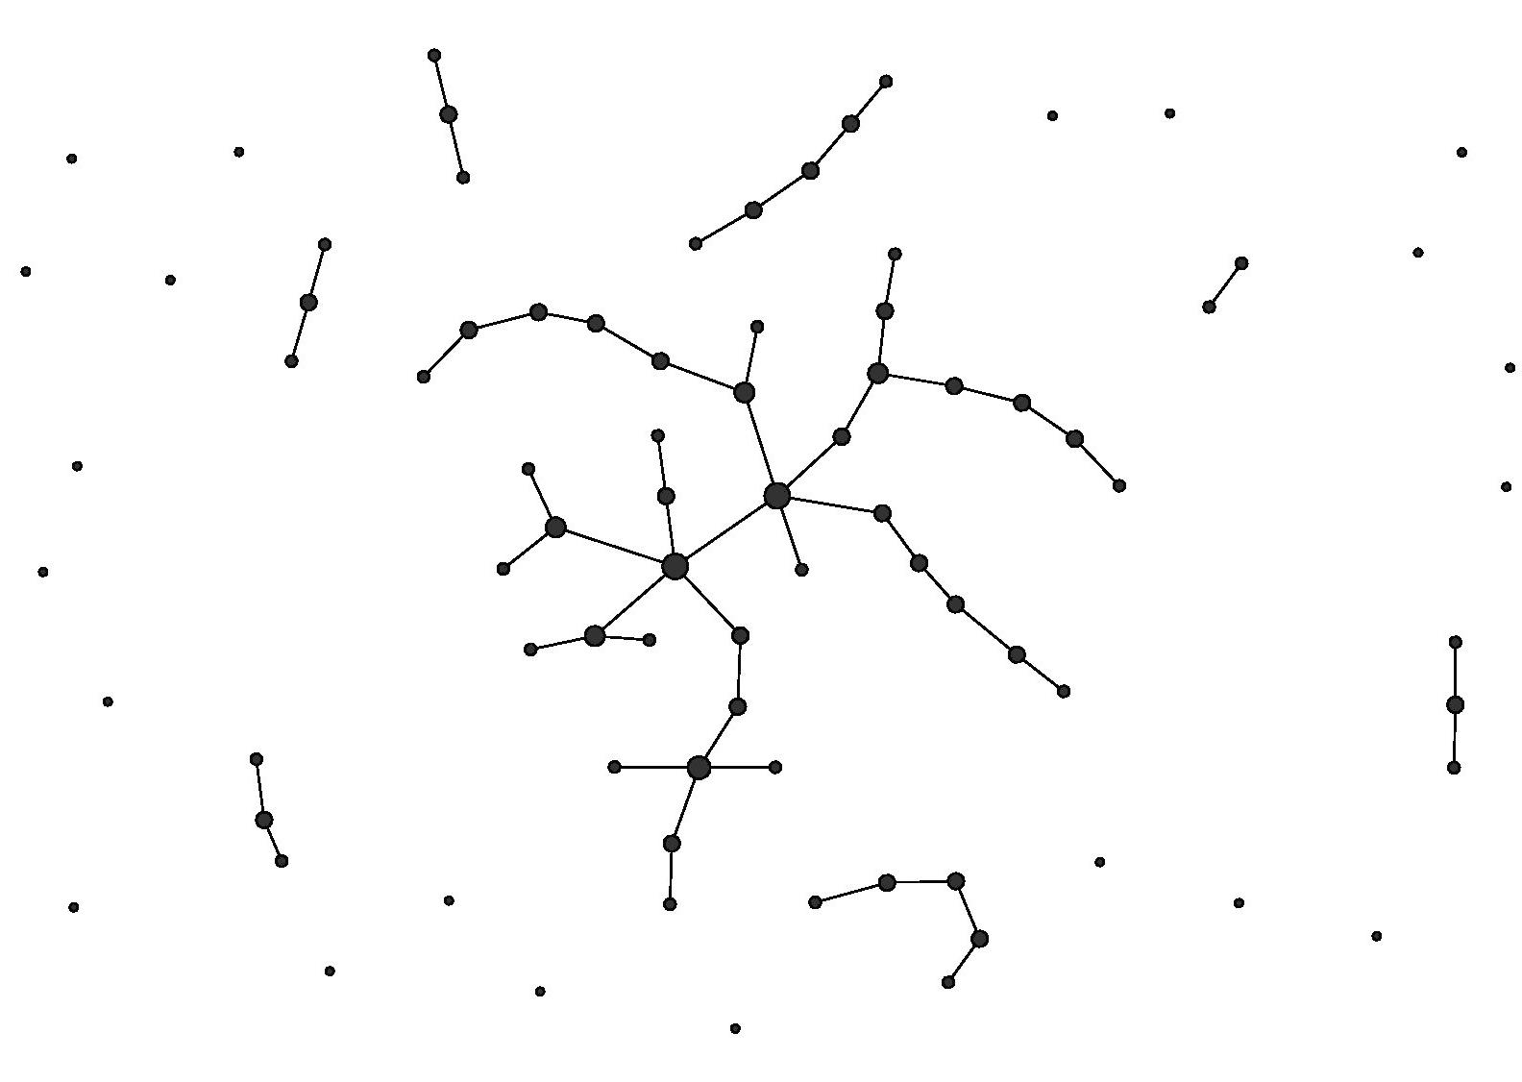
Null models
Erdõs-Rényi model
https://luisospina.wordpress.com/random-graph-models/

Slide 140
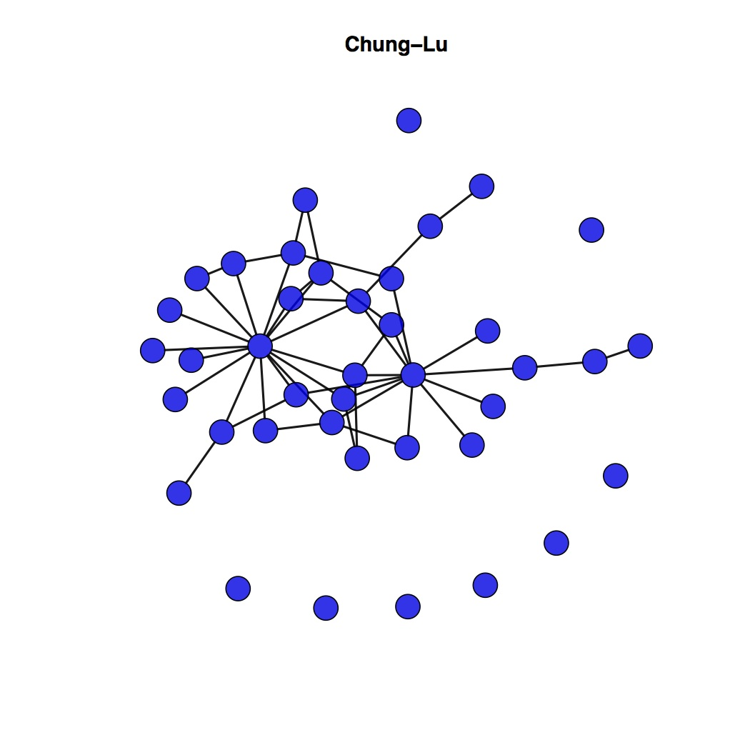
Null models
Erdõs-Rényi model Chung-lu model
https://luisospina.wordpress.com/random-graph-models/

Slide 141
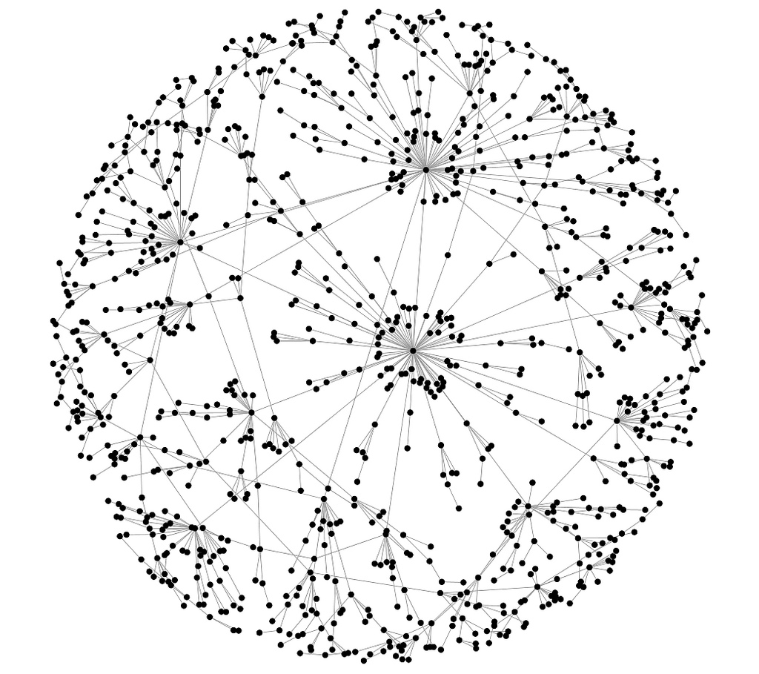
Null models
Erdõs-Rényi model Chung-lu model Klemm-Eguíluz
https://luisospina.wordpress.com/random-graph-models/

Slide 142
Null models
Erdõs-Rényi model Chung-lu model Klemm-Eguíluz
Random network
https://luisospina.wordpress.com/random-graph-models/

Slide 143
Null models
Erdõs-Rényi model Chung-lu model Klemm-Eguíluz
Random network
Random network
with non-random degree distribution
https://luisospina.wordpress.com/random-graph-models/

Slide 144
Null models
Erdõs-Rényi model Chung-lu model Klemm-Eguíluz
Random network
Random network
with non-random degree distribution
Scale-free network
https://luisospina.wordpress.com/random-graph-models/

Slide 145
Null models
Erdõs-Rényi model Chung-lu model Klemm-Eguíluz
Random network
Random network
with non-random degree distribution
Scale-free network
https://luisospina.wordpress.com/random-graph-models/

Slide 146
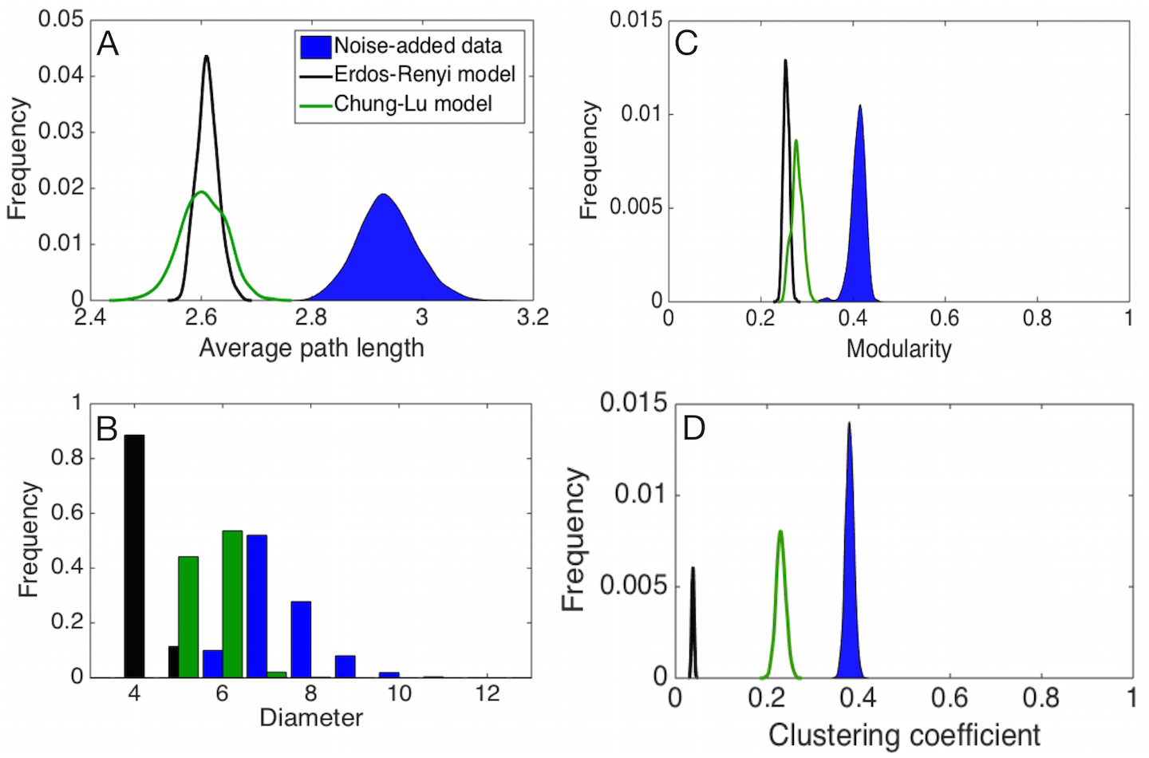
Null models
Infer network properties unique to your network
Connor, Barberán & Clauset. (2017). Using null models to infer microbial co-occurrence networks. PloS one, 12(5), e0176751.

Slide 147
Null models
Infer network properties unique to your network
Connor, Barberán & Clauset. (2017). Using null models to infer microbial co-occurrence networks. PloS one, 12(5), e0176751.

Slide 148
Null models
Infer network properties unique to your network
Connor, Barberán & Clauset. (2017). Using null models to infer microbial co-occurrence networks. PloS one, 12(5), e0176751.

Slide 149
Null models
Infer network properties unique to your network
Connor, Barberán & Clauset. (2017). Using null models to infer microbial co-occurrence networks. PloS one, 12(5), e0176751.

Slide 150
Recap
Optimal centralities cannot be suggested

Slide 151
Recap
Optimal centralities cannot be suggested
Domain knowledge can be integrated into networks

Slide 152
Recap
Optimal centralities cannot be suggested
Domain knowledge can be integrated into networks
Keystoneness is unknown until validated experimentally

Slide 153
Recap
Optimal centralities cannot be suggested
Domain knowledge can be integrated into networks
Keystoneness is unknown until validated experimentally
Cluster analysis can yield biological insights

Slide 154
Recap
Optimal centralities cannot be suggested
Domain knowledge can be integrated into networks
Keystoneness is unknown until validated experimentally
Cluster analysis can yield biological insights
Error rates are probably considerable; Use approaches that are not sensitive to errors

Slide 155
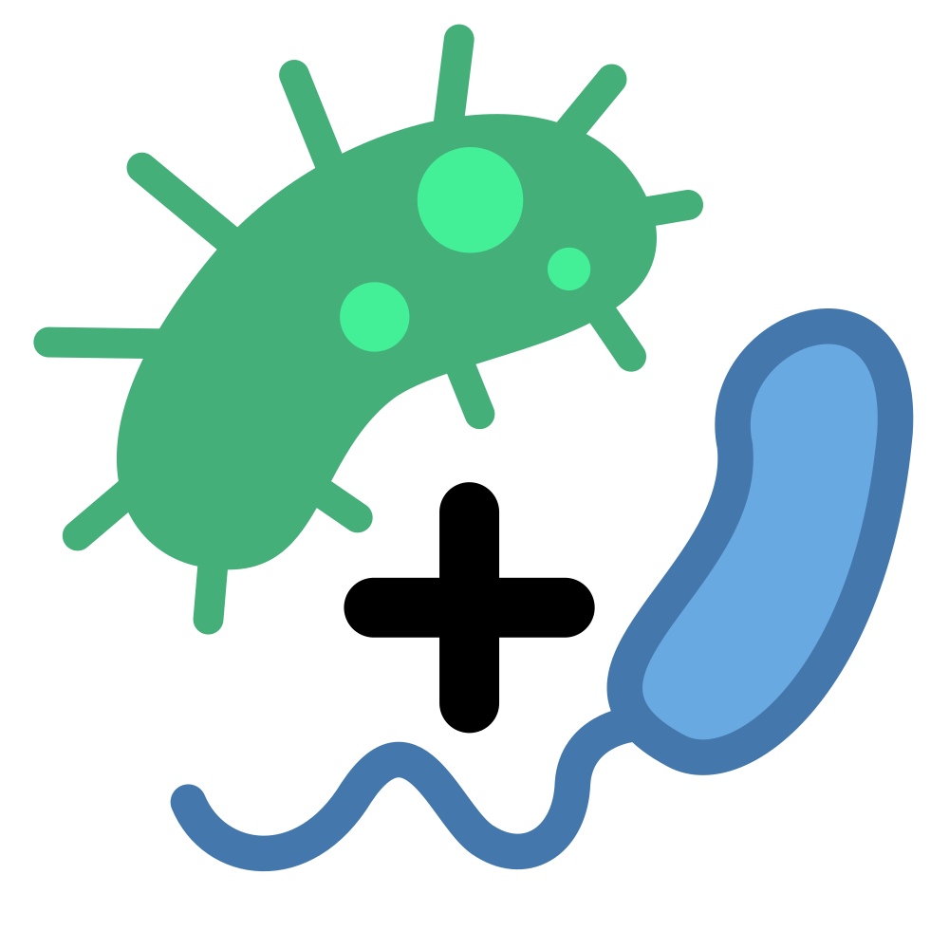
Thank you for listening!
Carry out network analysis on your SPIEC-EASI network: https://ramellose.github.io/networktutorials/workshop_MDA.html

